Slide 1

Sigurnost računala i podataka
Mario Čagalj
Sveučilište u Splitu
11.10.2011.

Slide 2
Overview of Computer Security
Computer Security: Principles and Practice
by William Stallings and Lawrie Brown
Introduction to Computer Security
by Matt Bishop
Produced by Mario Čagalj

Slide 3
Computer Security
By NIST (National Institute of Standards and Technology) Computer Security Handbook
  The protection afforded to an automated information system in order to attain the applicable objectives of preserving the integrity, availability and confidentiality of information system resources (includes hardware, software, firmware, information/data, and telecommunications).

Slide 4
Key Computer Security Concepts
Computer security rests on CIA
  Confidentiality (hrv. povjerljivost, tajnost)
  Integrity (hrv. cjelovitost)
  Availability (hrv. dostupnost)
The fundamental security objectives for both data and computing services (i.e., hardware, software, data, telecomunications)
The exact interpretation of the three aspects depends on the context in which they arise
Data and services
Confidentiality
Integrity
Avaliability

Slide 5
Confidentiality
Refers to hiding of information or resources
  Only authorized people or systems can access protected data
But also applies to the existence of data/resource
  Sometimes more important than the data itself (privacy)
  “A politician accused of corruption” more relevant than “the politician payed 1000$ bribe to fix the drunken-driving case”
Access control mechanisms support confidentiality
  Access control through encryption (cryptography)
  Access control by means of passwords and permissions
  Can you name an important difference between the two?

Slide 6
Integrity (1/2)
Integrity refers to the trustworthiness (hrv. vjerodostojnost) of data or resources
  Data integrity: assures that information and programs are changed only in a specified and authorized manner
  System integrity: assures that a system performs its intended function in a manner free from unauthorized manipulations
  Origin integrity (authentication): refers to confidence in the validity of a message and/or message originator
    Example: A newspaper prints information obtained from a leak at the White House but attribute it to the wrong source. The information is printed as received (preserving data integrity), but its source is incorrect (corrupting origin integrity).

Slide 7
Integrity (2/2)
Integrity protection mechanisms falls into two classes
  Prevention mechanisms
    Block any unauthorized attempts to change the data or to change the data in unauthorized ways (authentication and access control)
  Detection mechanisms
    Detection mechanisms do not try to prevent violations of integrity; they simply report that the data’s integrity is no longer trustworthy (e.g., crypto hash and MAC functions, digital signatures)
Does confidentiality imples integrity (in general)?

Slide 8
Example: Confidentiality vs. Integrity
Encrypt a message (with DES in ECB mode):
  “Bob’s salary is $25000--Tom’s salary is $15000.”
Resulting ciphertext (hex encoding):
  ED D8 87 15 73 A6 58 50 44 9E 95 11 B8 5B B8 33 58 6F 20 82 AA 83 F7 5E ED FD B0 2A C5 4B E3 2E 44 9E 95 11 B8 5B B8 33 7C 09 8C 04 DF 04 A9 E6
An attacker has an access to the ciphertext
  But doesn’t hold the encryption key so can’t read the message
  However he can modify the ciphertext
  ED FD B0 2A C5 4B E3 2E 44 9E 95 11 B8 5B B8 33 58 6F 20 82 AA 83 F7 5E ED D8 87 15 73 A6 58 50 44 9E 95 11 B8 5B B8 33 7C 09 8C 04 DF 04 A9 E6
An autorized party (holding the encryption key) decrypts
  “Tom’s salary is $25000--Bob’s salary is $15000.”
  Is this a trustworthy message (confidentiality preserved)?

Slide 9
Avaliability
Availability refers to the ability to use the information or resource desired
  Unavailable system is at least as bad as no system at all
  The aspect of availability that is relevant to security is that someone may deliberately arrange to deny access to data or to a service by making it unavailable
  Denial-of-Service (DoS) attacks are attempts to block avaliability
When designing/engineering new systems, this aspect is often neglected – a very bad practice

Slide 10

Example: SYN Flooding DoS Attack
TCP 3-way handshake
SYN flooding
Client
Server
Client
Server
SYN=1
Wait
SYN=2
SeqC=3000, SYN=1
SYN=3
Store data
SYN=4
SeqS=5000, SYN=1,
AckS=3001, ACK=1
SYN=1, ACK=1
Store data
SYN=2, ACK=2
Wait until
timeout
SYN=3, ACK=3
SeqC=3001,
AckC=5001, ACK=1
SYN=4, ACK=4
Wait until
timeout
TCP connection
established
time
time
Backlog queue fills up with
half-open connections.

Slide 11
Security Terminology (RFC 2828)
System resource (asset to be protected)
  Hardware, software, data, communication facilities and nets
Vulnerability
  A flaw or weakneses in a system’s desing, implementation, or operation that can be exploited to violate a security policy
Security policy
  A set of rules stating what is allows and what is not allowed
Adversary
  An entity attacking or threatening to a system
Attack
  An assault on system security from an intelligent threat
Threat
  A potential violation of security (potentially exploits a vulnerability)
Risk
  An expetation of loss expresses as probability that a particular threat will exploit a particular vulnerability with a particular loss incurred
Countermeasure
  An action that reduces a threat, a vulnerability, or an attack

Slide 12
Relations Among Security Terms
value
owners
wish to minimize
impose
to reduce
countermeasurs
that may poses
vulnerabilities
may be aware of
leading
to
adversary
give rise to
risk
that increase
to
threats
assets
to
wish to abuse and/or may damage

Slide 13
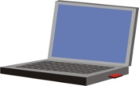
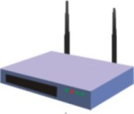
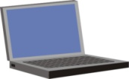
Vulnerabilities and Attacks
System resource (asset) vulnerabilities
  May be corrupted (loss of integrity)
  Become leaky (loss of confidentiality)
  Become unavaliable (loss of avaliabity)
Attacks are threats carried out and may be
  Passive (wiretapping, snooping)
  Active (Man-in-the-Middle, Man-in-the-Browser)
  Insider
  Outsider
User 1
MITM attacker
User 2

Slide 14
Example: ARP Spoofing Threat (1/2)
Masquerading or spoofing attack
  ARP (Address Resolution Protocol) spoofing
  ARP maps IP to MAC addresses
08:00:20:03:F6:42
00:00:C0:C2:9B:26
.1
.2
.3
.4
.5
140.252.13
arp req | target IP: 140.252.13.5 | target eth: ?
08:00:20:03:F6:42
00:00:C0:C2:9B:26
.1
.2
.3
.4
.5
140.252.13
arp rep | sender IP: 140.252.13.5 | sender eth: 00:00:C0:C2:9B:26

Slide 15
Example: ARP Spoofing Attack (2/2)
Another machine sends an unsolicited ARP reply
08:00:20:03:F6:42
00:00:C0:C2:9B:26
.1
.2
.3
.4
.5
140.252.13
arp req | target IP: 140.252.13.5 | target eth: ?
08:00:20:03:F6:42
00:34:CD:C2:9F:A0
00:00:C0:C2:9B:26
.1
.2
.3
.4
.5
140.252.13
arp rep | sender IP: 140.252.13.5 | sender eth: 00:34:CD:C2:9F:A0

Slide 16
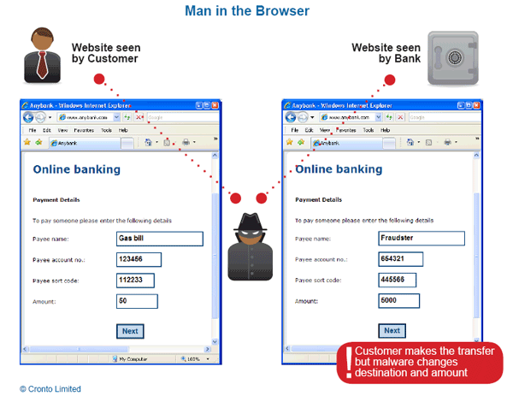
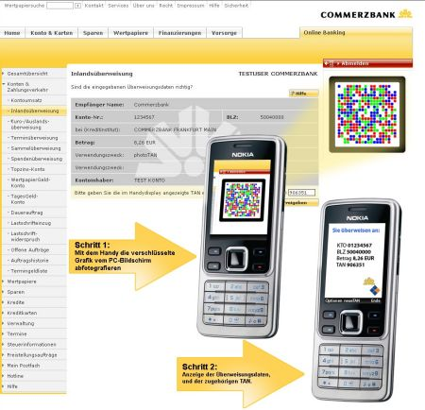
Example: Man-in-the-Browser (MitB)
MitB is a trojan that infects a web browser and has the ability to modify pages, modify transaction content or insert additional transactions
SSL/PKI and/or Two or Three Factor Authentication do not help
  The only way to counter a MitB attack is by utilizing transaction verification
Out-of-Band channel

Slide 17
Threats and Attacks
Unauthorized disclosure – a threat to confidentiality
  Exposure, interception, inference, intrusion
Deception – a threat to either system or data integrity
  Masquerade, falsification, repudiation
Disruption – a threat to avaliability or system integrity
  Incapacitation (attack on system avaliability), corruption (system integrity), obstruction (interference with communicaiton)
Usurpation – a threat to system integrity
  Misappropriation (a theft of service, using other machines to perform DDoS), misuse (security functinos disabled by malicious logic or a hacker)

Slide 18


Scope of Computer Security
Asset categories: hardware, software, data, and communication nets
Computer System
Computer System
4. Sensitive files must be secured (file security)
Data
3. Data must be securely transmitted through networks (network security)
Data
1. Access to
the data must be controlled (protection)
Users’ processes
Users’ processes
Guard
Guard
2. Access to the computer facility must be controlled (user authentication )
Users making requests

Slide 19
Computer Assets and Some Threats
 | Avaliability | Confidentiality | Integrity
Hardware | Equipment is stolen or disabled, thus denying service.
Software | Programs are deleted, denaying access to users. | An unauthorized copy of software is made. | A working program is modified to cause it to fail or to cause it to do some unintended task.
Data | Files are deleted, denying access to users. | An unauthorized read of data is performed. An analysis of statistical data reveals underlaying data. | Existing files are modified or new files are fabricated.
Communication Lines | Messages are destroyed or deleted. | Messages are read. Traffic patterns are observed. | Messages are modified, destroyed, reordered, duplicated. False messages are injected.

Slide 20
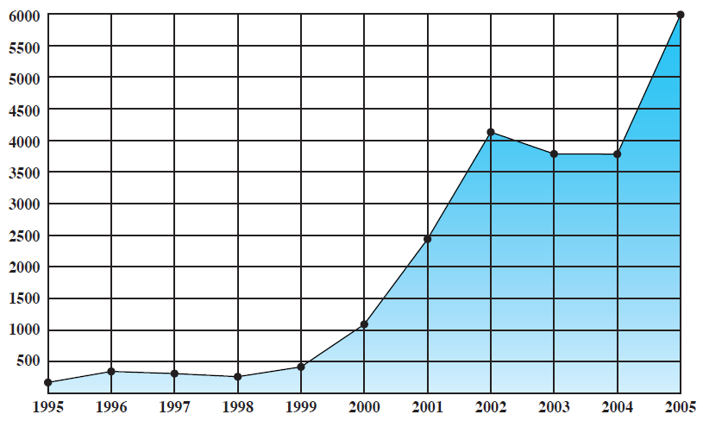
Computer Security Trends (1/4)
CERT (Computer Emergency Response Team) report – Internet related vulnerabilities (flaws in operating systems, routers, network devices)

Slide 21
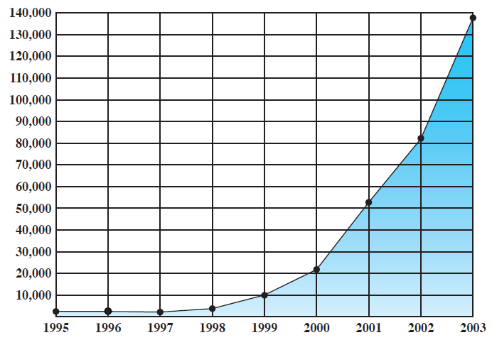
Computer Security Trends (2/4)
Incidents reported (incident: a group of attacks that can be distinguished from other attacks because of distinctiveness of the attackers, attacks, objectives, sites, and timing)

Slide 22
Computer Security Trends (3/4)
By Tim Shimeall, ©CMU
Auto
Coordinated
Cross site scripting
Tools
“stealth” / advanced scanning techniques
High
packet spoofing
denial of service
Staged
sniffers
distributed
attack tools
Intruder
Knowledge
sweepers
www attacks
automated probes/scans
GUI
back doors
disabling audits
network mgmt. diagnostics
hijacking
sessions
burglaries
Attack
Sophistication
exploiting known vulnerabilities
password cracking
self-replicating code
Intruders
Low
password guessing
1980
1985
1990
1995
2000

Slide 23
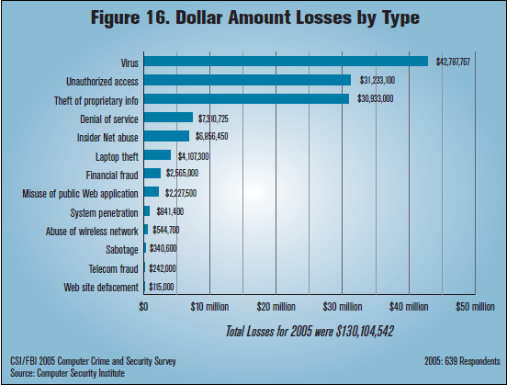
CSI/FBI 2005 Computer Crime and Security Survey

Slide 24
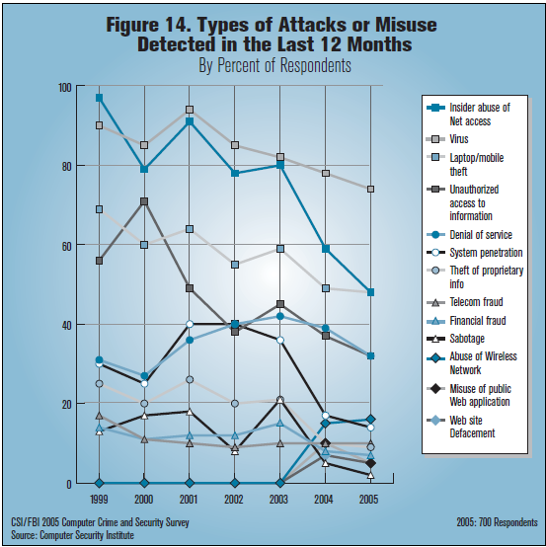
CSI/FBI 2005 Computer Crime and Security Survey

Slide 25
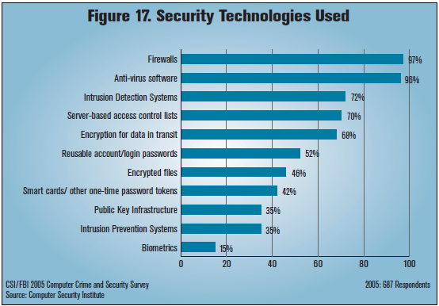
CSI/FBI 2005 Computer Crime and Security Survey

Slide 26
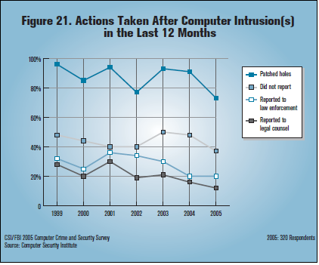
CSI/FBI 2005 Computer Crime and Security Survey

Slide 27
Computer Security Strategy
Involves three aspects
  Specification/policy: What is security scheme supposed to do?
    The value of the assets being protected
    The vulnerabilites of the system
    Potential threats and the likelihood of attacks
    Also important:
    Easy of use versus security
    Cost of security versus cost of failure and recovery
  Implementation/mechanisms: How does it do it?
    Prevention, detection, response, recovery
  Correctness/assurance: Does it really work?
    Assurance – the degree of confidence one has that the security measures work as intended
    Evaluation (testing)

Slide 28
Closing Words
Computer security attempts to ensure confidentiality, integrity, and avaliability of computer system’s assets
Four important principles
  Easieast penetration – consider at once all aspects of the system
  Timeliness – a system must be protected against penetration only so long as the penetration has value to penetrator
  Effectiveness – usable and used protection controls
  The weakest link principle – security is no stronger than its weakest point
Countermeasures (controls) can be applied at the levels of the data, the programs, the system, the hardware, the comm. links, the enviroment and the personel
  Sometimes several controls needed to cover a single vulenrability

Slide 29
Topics for a Course Project
Mario Čagalj

Slide 30
Tentative (Open-end) List
Penetration testing
Writing a simple keylogger
Fuzzing
Buffer overflow
Access control in Linux and Windows
Setting up and managing and Active Directory
OpenVPN
Cracking passwords using Rainbow tables
DoS and DDoS
Using TPM for advanced system protection
DB security (MySQL)
Drive encryption
SFTP, SSH
QR and MitB
...

